Slide 1
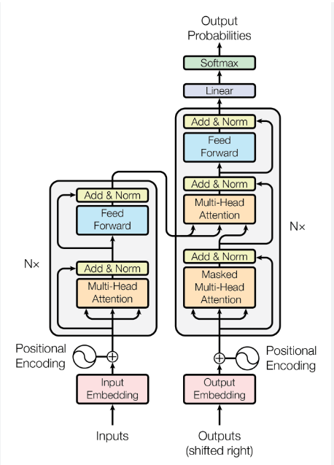
In this presentation I will explain how a transformer model with a multi head attention is used for building a chat bot. Below we can see a transformer model architecture.
encoder
decoder

Slide 2
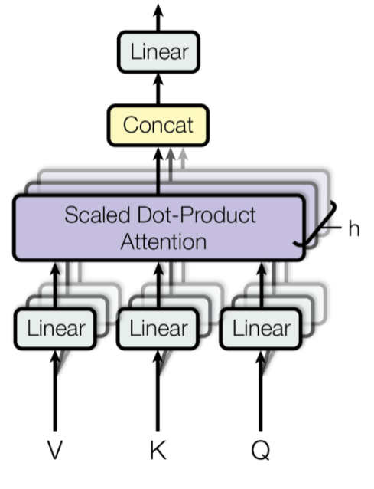
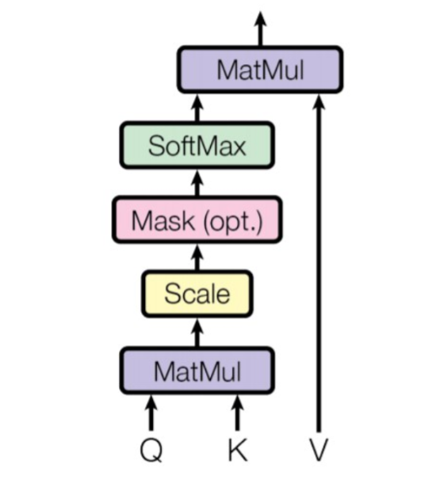
Here is shown an architecture of a multi head attention and a scaled dot product attention.

Slide 3

V, K and Q shown in the slide with an attention are so called values, keys and queries which are matrixes. In case of building a chat bot those matrixes represents sentences. In attention in encoder V, K and Q are the same. The same is for the first attention in decoder .
The ‘linear’ operation shown in a picture indicates a linear projection. That means that we are multiplying V, K and Q by matrixes with weights W_v, W_k and W_q (I am not sure but I think that we are also adding a bias to those values except for multiplying by weights). Those weights are a trainable parameters of a model. V, K and Q multiplied by weights are the input for scaled dot product attention.
We multiply V, K and Q by h different sets of matrixes W_v, W_k and W_q and they are a seperate inputs for scaled dot product attention. Then we concatenate all the results from scaled dot product attention and again multiply by a matrix with weights to get a final output.

Slide 4
Annotations
X will be representing a question which we ask to our chat bot and Y will be representing an answer. They are both matrixes where each row represents a single word. X[i][j] indicates a value in the i-th row and j-th column. In order to change words into vectors we can use word embeddings models.

Slide 5
How a transformer generates an answer for a question
Y at the begining is a matrix with only zeros.
X, Y -> transformer(X, Y) = v1 -> v1 is a vector representing the first generated word. We assign v1 to Y[0].
X, Y -> transformer(X, Y) = v2 -> Now Y doesn’t consist only from zeros because Y[0] = v1. Now we assign v2 to Y[1].
We continue doing this until model generates a special ‘End’ token which indicates that this is the end of a sentence

Slide 6
During a training our Y doesn’t consist only from zeros so before we pass it to a transformer model we need to mask (convert to zero or -inf) all the words from Y which were not generated by a model yet. This masking operation is being done within an attention function.
X, Y -> mask all rows in Y -> transformer(X, Y) = v1
X, Y -> mask all rows in Y except for the first row -> transformer(X, Y) = v2
X, Y -> mask all rows in Y except for the first two rows -> transformer(X, Y) = v3
We continue doing this until we reach the end of Y
Then we compare all generated words v1, v2, ... with the real values from Y

Slide 7
More details about transformer’s operations
x // question sentence
y // answer sentence
def transformer(x, y, mask):
  // changing words into a vectors using an embedding model
  x = embedding(x)
  x = positional_encoding(x)
  // we use an encoder N times
  for i in range(N):
  x = encoder(x)
  y = embedding(y)
  y = positional_encoding(y)
  // we use a decoder M times
  for i in range(M):
  y = decoder(y, x, mask)
  return y

Slide 8
Decoder function:
def decoder(y, encoder_output, mask):
query, key, value = y
output = mha(value, key, query) // multi head attention
output = Norm(y + output) // normalization
value, key = encoder_output
query = output
output = mha(value, key, query, mask = mask) // masked attention
output = Norm(y + output)
output = Norm(output + feed_forward(output))
return output

Slide 9
In the multi head attention function mha() argument mask indicates which values from variables ‘value’, ‘key’ and ‘query’ will be masked (converted to 0 or -inf). For example if mask = 2 then all rows of ‘value’, ‘key’ and ‘query’ except for the first two rows will be converted to 0 or -inf.

